Slide 1
DATE: 18th Sep 2024
KYOTO GRAND OPENING GOODS

Slide 2
Only ROCK SHOP
ROCK SHOP 限定：
Grand Opening Guitar Pin
￥2,530
LE 500
Grand Opening Tee Black
￥5,280

Slide 3
Only OFFSITE
ONLINE SHOP 限定：
Grand Opening Tee Gray
￥5,280
Grand Opening Logo Pin
￥2,530
LE300

Slide 4
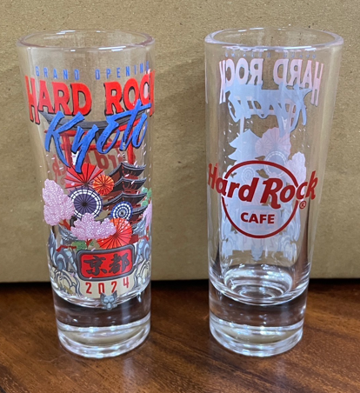
ROCK SHOP & OFFSITE
ONLINE SHOP & OFFSITE：
Grand Opening Hoodie Navy
￥9,570
Grand Opening Tote
￥3,630
Grand Opening Shot
￥1,540
Grand Opening KC
￥2,530
Grand Opening Magnet
￥2,860
Grand Opening Staff Pin

Slide 5
THANK YOU!

